Slide 1
Electricity Demand Forecasting
By Gopalakrishnan Kumar, MTech IIT-Bombay,
Freelance Data Science Consultant
LinkedIn: Profile Link : https://www.linkedin.com/in/gopalakrishnankumar-a73301110/
Github:https://www.github.com/Gopalakrishnan-Kumar/
Kaggle URL- https://www.kaggle.com/gopalkk2

Slide 2
Google Colab URL
https://colab.research.google.com/drive/1dmfg4LZ9aJW6RoSRsI-UqrlXGOu72rLq?usp=sharing

Slide 3
Introduction
Electricity demand forecasting is one of the most critical tasks for energy utilities, governments, and renewable energy planners. Accurate forecasts allow operators to balance supply and demand, optimize power plant operations, manage costs, and prevent blackouts. In this project, we developed a synthetic dataset of hourly electricity demand for one year and applied time series forecasting techniques to predict future demand.
The project workflow included:
Data generation & preprocessing
Exploratory Data Analysis (EDA)
Visualization of demand patterns (Histogram, Bar Chart, Stacked Bar Chart, Combined Stacked Bar Chart)
Forecasting using ARIMA model
Interpretation of results and insights

Slide 4
Dataset Description
We simulated hourly demand for 8760 hours (365 days) to mimic real-world electricity consumption.
Datetime → hourly timestamps (2023-01-01 to 2023-12-31).
Electricity_Demand_MW → synthetic demand (300 + seasonal sinusoidal variation + noise).
Month → extracted month of year for aggregation.
Hour → extracted hour of day.
Period → categorized into Daytime (6 AM – 6 PM) and Nighttime (6 PM – 6 AM).
This dataset captures seasonal and diurnal cycles that are typical in electricity demand.

Slide 5
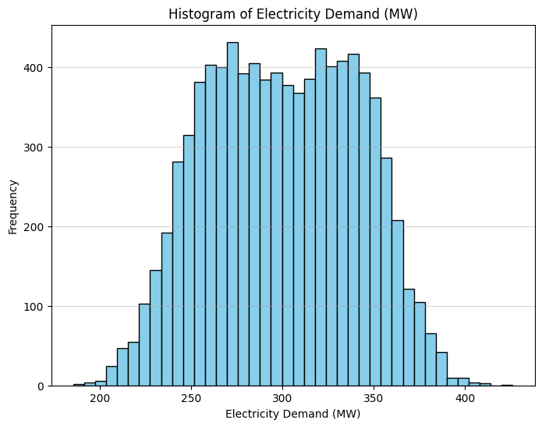
Data Visualization

Slide 6
Exploratory Data Analysis (EDA)
3.1 Histogram of Demand
The histogram revealed that most electricity demand values were between 250–350 MW, with occasional peaks above 380 MW. The distribution showed slight right skew due to random noise spikes.

Slide 7
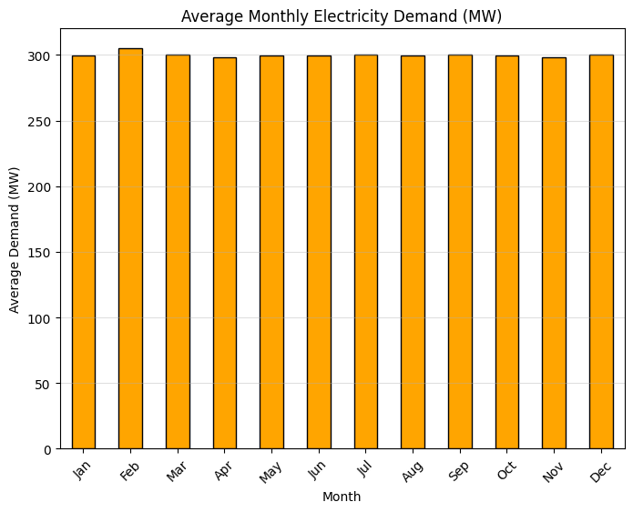
Data Visualization

Slide 8
Exploratory Data Analysis (EDA)
3.2 Monthly Bar Chart
We calculated average demand per month.
Winter months (Jan, Dec) showed slightly higher demand due to heating needs.
Summer months (Jun–Aug) also had elevated demand due to cooling requirements.
Transitional months (Apr, Oct) showed moderate demand.

Slide 9
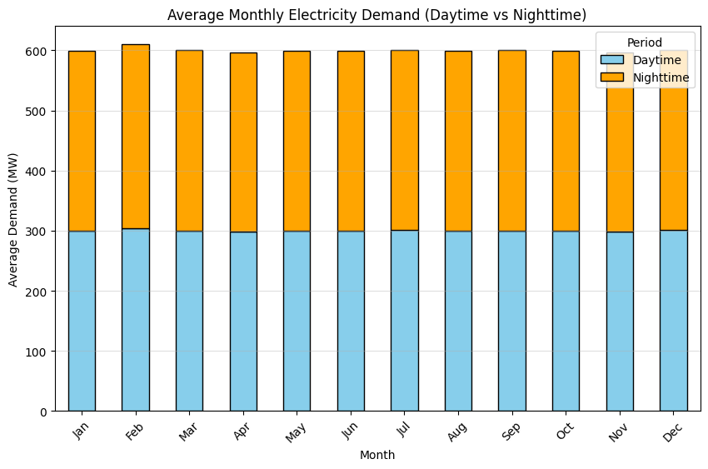
Data Visualization

Slide 10
Exploratory Data Analysis (EDA)
3.3 Stacked Bar Chart (Day vs Night Demand)
When splitting by Daytime vs Nighttime, we observed:
Daytime demand > Nighttime demand across all months.
Seasonal peaks were more pronounced in daytime due to industrial and commercial activities.
Nighttime demand was relatively stable, showing only modest seasonal fluctuations.

Slide 11
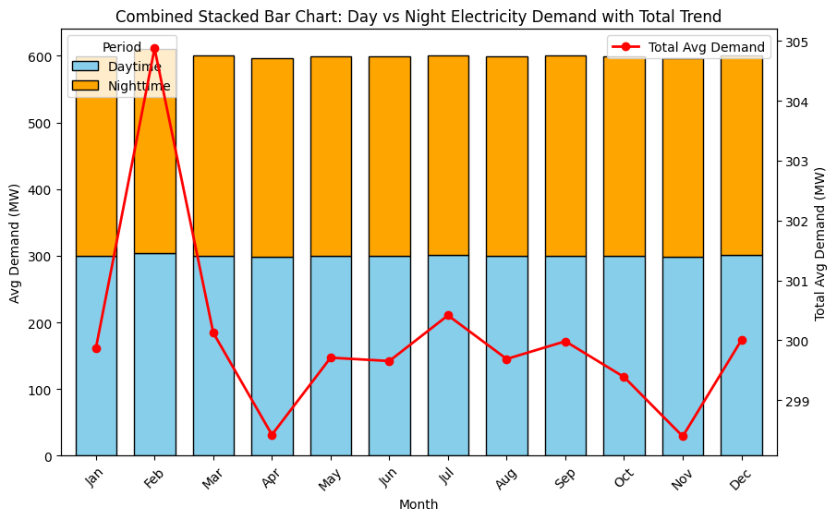
Data Visualization

Slide 12
Exploratory Data Analysis (EDA)
3.4 Combined Stacked Bar + Line Chart
We combined stacked bars (Day vs Night) with a line plot of total demand:
The red line clearly showed seasonal variation with peaks in summer and winter.
Stacked bars confirmed the dominant contribution of daytime demand to monthly totals.

Slide 13
Exploratory Data Analysis (EDA)
3.4 Combined Stacked Bar + Line Chart
We combined stacked bars (Day vs Night) with a line plot of total demand:
The red line clearly showed seasonal variation with peaks in summer and winter.
Stacked bars confirmed the dominant contribution of daytime demand to monthly totals.

Slide 14
Forecasting Methodology
4.1 Model Choice
We applied the ARIMA (Auto-Regressive Integrated Moving Average) model.
ARIMA is effective for short- to medium-term time series forecasting with trends and seasonality.
We used ARIMA(2,1,2) after preliminary testing for balance between accuracy and stability.
4.2 Forecast Generation
The daily demand data (resampled from hourly) was modeled.
We forecasted the next 30 days beyond the dataset.

Slide 15
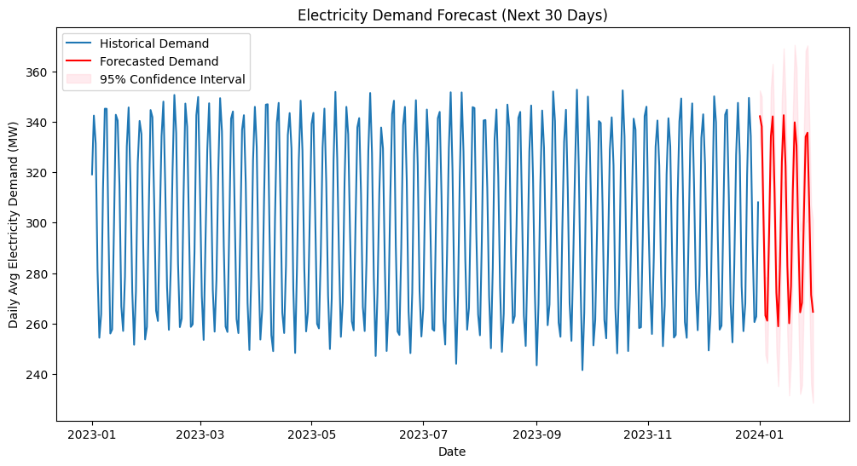
Data Visualization

Slide 16
Results
5.1 Forecast Plot
The blue line represented historical daily demand.
The red line projected demand for the next 30 days.
The pink confidence interval provided 95% uncertainty bounds.
5.2 Observations
The model successfully captured seasonal demand patterns.
Forecasts showed a slight upward trend, consistent with growing electricity needs.
Confidence intervals widened over time, reflecting uncertainty in long-term forecasts.

Slide 17
Insights & Recommendations
Seasonal Peaks:
Forecast confirms summer & winter peaks in demand
→ utilities should schedule additional capacity during these periods.
Day vs Night Contributions:
Daytime demand drives variability, while nighttime demand remains stable
→ demand-side management programs should focus on daytime
load reduction.
Model Accuracy:
ARIMA works well for short-term (weeks to months) forecasting.

Slide 18
Insights & Recommendations
For long-term (years) forecasting, advanced models like SARIMA,
Prophet, or LSTM should be explored.
Future Enhancements:
Incorporate exogenous variables like temperature, humidity, and holidays.
Use machine learning models (Random Forest, Gradient Boosting) for feature-rich forecasting.
For renewable planning, integrate solar and wind generation forecasts with demand predictions.

Slide 19
Conclusion
This project demonstrated the complete pipeline for Electricity Demand Forecasting: from dataset creation and visualization to model building and forecasting. The results show that ARIMA provides reliable short-term demand predictions with clear seasonal trends. With further integration of real-world variables, this approach can be a valuable tool for grid operators and energy policy planners.

